Slide 1





Innovation : cloudClass for Students
Nilesh bhambale, Kushal patil,Aniket patil, Pratik Sulakshane,Om Surve
Department of Computer Application
G. H. Raisoni Institute of Engineering and Business Management
Jalgaon
cloudClass

Slide 2

DESCRIPTION –:
FIRST OF ALL THE CLOUD CLASS IS A EDUCATIONL PURPOSE WISE DESIGNED.
IT CONTAINS THE ALL INTERACTIONS BETWEEN TEACHERS AND STUDENTS

Slide 3
OUR PROJECT CONTAINS FOLLOWING KEY POINTS:
Our web Application contains attendance for all faculty and students .
Our web Application manages staff leaves management and students absentees too .
Our web Application also provides a feature to upload and receive educational material .
Our web Application provide Test series related to each and every stream .
Our web Application generates the Test result and their marksheet .
Our web Application also gives the deadlines of the student benefits , all eligible scholarships and government facilities .
Our web Application also provides the event memories in the form of photos and videos .

Slide 4

Our web Application contains attendance for all faculty and students .

Slide 5

Our web Application manages staff leaves management and students absentees too .

Slide 6
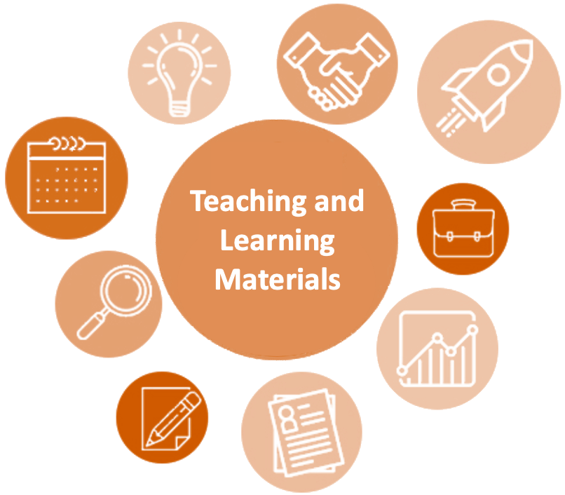
Our web Application also provides a feature to upload and receive educational material .

Slide 7

Our web Application provide Test series related to each and every stream .

Slide 8

Our web Application generates the Test result and their marksheet .

Slide 9

Our web Application also gives the deadlines of the student benefits , all eligible scholarships and government facilities .

Slide 10

Our web Application also provides the event memories in the form of photos and videos .

Slide 11
SOLUTIONS ON THE PROBLEMS :
1)We solves the attendances problems fluently .
2) Our project solves the problems of using one web Application instead of two.
3) We also solves the difficulties faced in leaves systems .
4) We also notify the each and every user something is uploaded a notice has been issued .
5) We solve the problems of conduction of test on every weekend on basis of portion previously teached.
6) We solved the problems of interaction between parents and admin.
7)We also shows students progress on exam and attendances we also solve the problem of teachers faced on daily basis.

